Slide 1
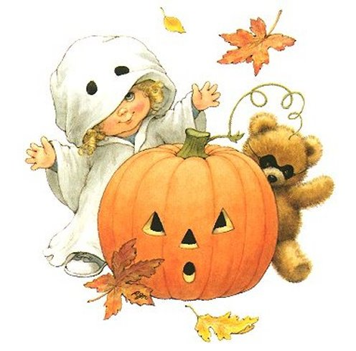
Halloween
Автор: Сторожева Т.А.

Slide 2
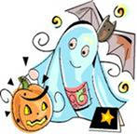
DO YOU KNOW…
31 October is Halloween. This festival celebrates the return of the souls of the dead who come back to visit places where they lived. In the evening there are lots of Halloween parties.

Slide 3
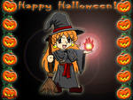
Do you know…
Many years ago a man named Jack lived in Ireland. One day he deceived the Devil. Jack made him to climb up the tree and put a cross on the tree. The Devil couldn’t climb down. When Jack died, he couldn’t get to the paradise. Jack wasn’t good enough. He couldn’t get to the hell because he deceived the Devil. It was given a smouldering coal to him to brighten his long way in the darkness. This coal was put in an empty turnip. Since then it is a tradition to light a candle. The Irish emigrants came to America and saw that it was more convenient to use a pumpkin instead a turnip.

Slide 4
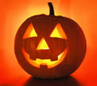
Jack-a- lantern
Here the instructions for the Halloween’s lantern are. They are mixed up. Put them in the correct order.
Cut two eyes, a nose, a mouth on one side of the pumpkin.
Cut the top and the bottom of the pumpkin.
Take out the pulp from inside the pumpkin.
Put ”the head” over the candle and light the candle.
Stand the candle in the bottom piece of the pumpkin.

Slide 5
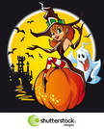
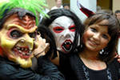
People dress up as witches, ghosts, devils, cats or bats

Slide 6
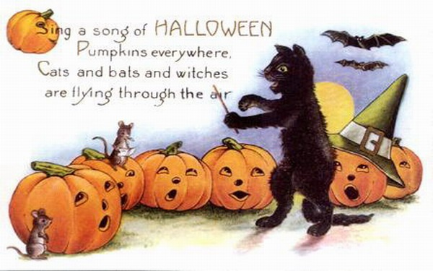
Song of halloween

Slide 7
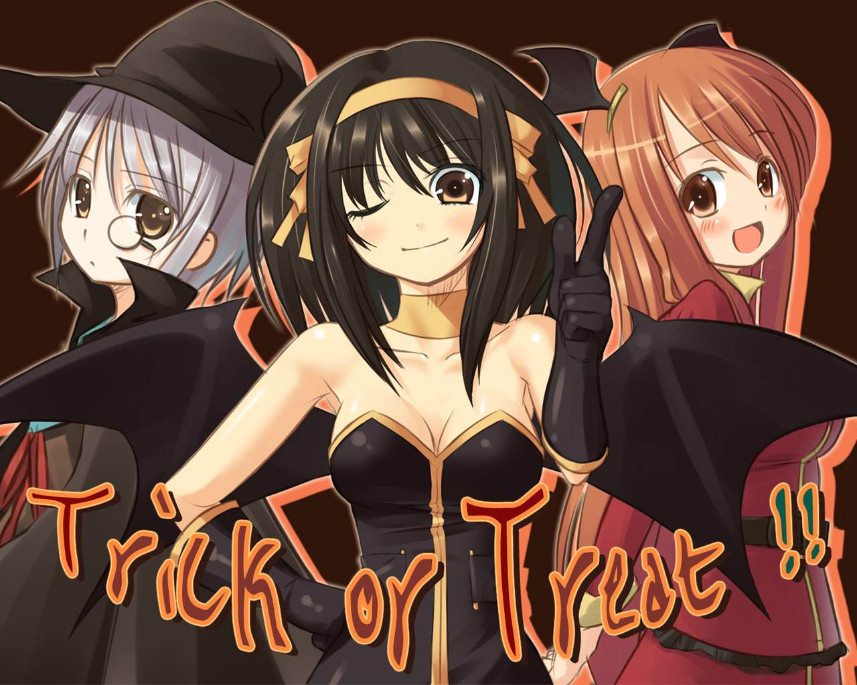
Trick or treat?
Some children follow the American tradition called Trick or Treat. They knock at your house and ask, ” Trick or Treat?” If you give them some money or sweets, they go away. If not, they play a trick on you, like splashing water at your face or soaping the windows of houses and cars.

Slide 8
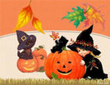
Poem
Trick or treat, trick or treat,
Give us something good to eat.
Give us candy, give us cake,
Give us something sweet to take.
Give us cookies, fruit and gum.
Hurry up and give us some.
You had better do it quick
Or we’ll surely play a trick.

Slide 9
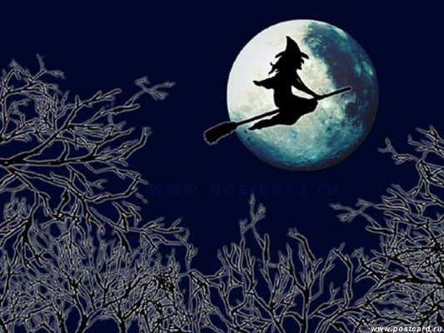
Puzzles
She always flies on her magic broom
She always flies around the moon
With a black hat on her head
And what do you think, who is that?
It means bad luck, don’t look at it
If it crosses your path
And what do you think we call it?
I am big and round
Once upon a time I grew on the ground
Now I have a mouth, two eyes and a nose
Who am I ? Do you suppose?
I see a friendly shining moon
As big and round as a balloon
Soon I will go out on the street
With my friend for our ____________ .

Slide 10
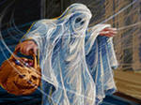
scary story
No Halloween party is complete without scary stories. Here it is one of them. In 1751 not far from the English town Tring a crowd beat up an old couple. They suspected old people of witchcraft. The man and his wife were drowned in the river. Later the leader of these cruel persons, Tom Kolly, was caught and hanged. After death penalty his body was left on the gallows in the cage of iron chains and hoops. At that time people believed that the soul of the man could not leave the Earth and go to paradise or to hell without a burial. A ghost of Kolly must wander in that place where his body was left. Some people say that he appears as a big black dog.

Slide 11
British superstitions
Good Luck
Black cats are lucky.
On the first day of the month it’s lucky to say “white rabbits”.
Catch falling leaves in autumn and you’ll have good luck. Every leaf means a lucky month in the next year.
If you see two magpies you’ll be happy.
Bad Luck
Never open the umbrella in the house.
Never break a mirror-that means 7 years bad luck.
Don’t go past somebody on the stairs.
The number 13 is very unlucky (and Friday the 13th is a very unlucky date).
Don’t walk under the ladder.

Slide 12
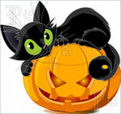
How superstitious are you?
Would you sleep in a hotel room numbered 13?
Would you be happy to sit for an important exam on Friday 13th?
Would it be important for you to have a “white wedding”?
Have you ever said, “Touch the wood”?
Do you ever cross your fingers as a sign of good luck?
If there were a ladder on the pavement, would you avoid walking under it?
Do you believe that if you praise someone too much? You might bring them bad luck?

