Slide 1
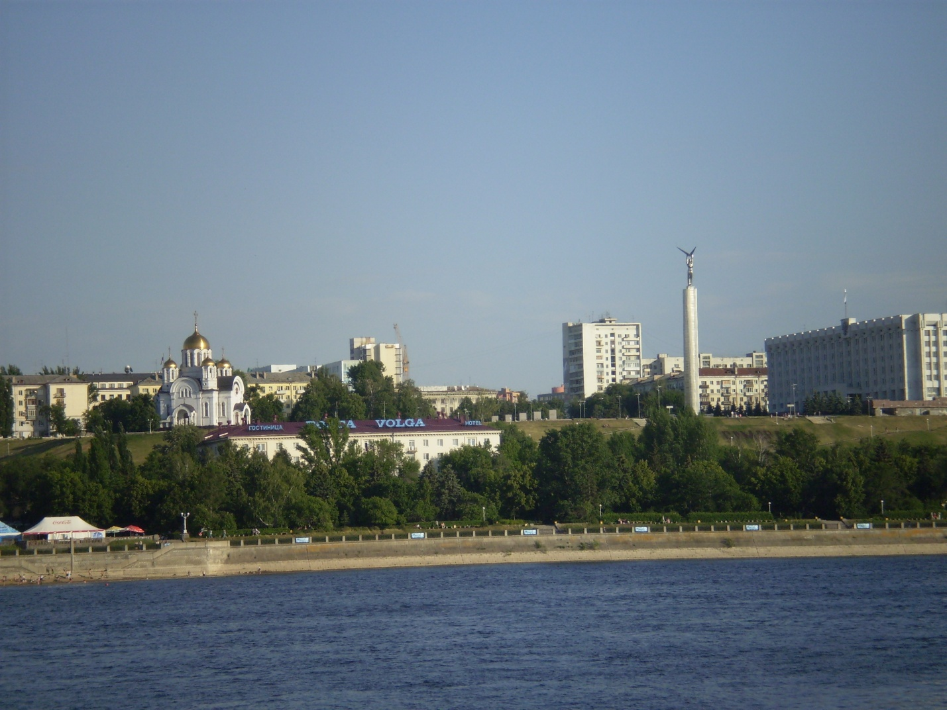
SAMARA

Slide 2
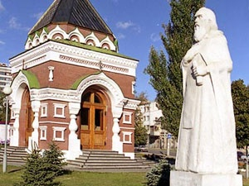
SAMARA WAS FOUNDED IN 1586 AS A LITTLE WOODEN FORTRESS TO GUARD THE RUSSIAN FRONTIERS FROM ENEMIES. ALEXIUS, METROPOLITAN OF MOSCOW, LATER PATRON SAINT OF SAMARA, VISITED THE SITE OF THE CITY IN 1357 AND PREDICTED THAT A GREAT TOWN WOULD BE ERECTED THERE, AND THE TOWN WOULD NEVER BE RAVAGED.

Slide 3
SAMARA IS SITUATED IN THE CENTRAL EUROPEAN PART OF THE COUNTRY, ON THE BANK OF THE RIVER VOLGA
OUR EMBANKMENT IN SUMMER AND IN WINTER

Slide 4
THERE ARE MANY SQUARES IN SAMARA. THE MAIN SQUARE IS KUIBYSHEV SQUARE. THE SQUARE IS NORMALLY THE PLACE OF OFFICIAL MEETINGS AND PARADES. IT IS THE LARGEST SQUARE IN RUSSIA.
IN SUMMER
IN WINTER

Slide 5
THE DRAMA THEATRE AND MONUMENT TO VASILY CHAPAYEV

Slide 6
PHILHARMONIC ORCHESTRA HALL

Slide 7
THE NEW, UNUSUAL – LOOKING RAILWAY STATION BUILDING WAS COMPLETED IN 2008.
AT NIGHT
DURING THE DAY

Slide 8
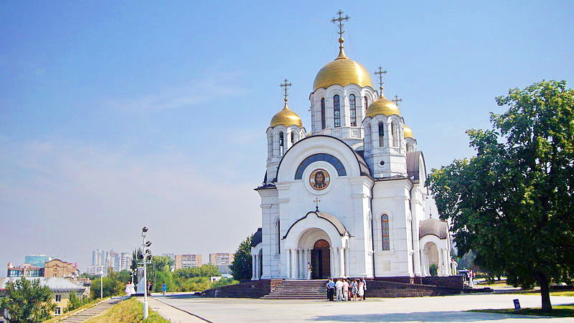
THERE ARE MANY CHURCHES IN SAMARA.
ST. GEORGE’S TEMPLE
THE PROTESTANT CHIRCH
THE ROMAN – CATHOLIC CHIRCH

Slide 9
LADYA-MONUMENT AND THE HIGHEST BUILDING IN SAMARA

Slide 10
NEW YEAR’S ILLUMINATION IN SAMARA

Slide 11
WELCOME TO SAMARA!

